Slide 1

House prices in Perth
Spiros basilakes
Thierry Zonneveld

Slide 2
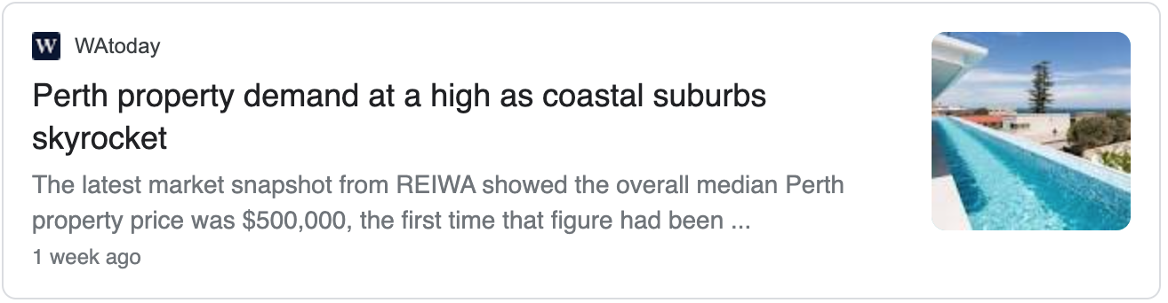
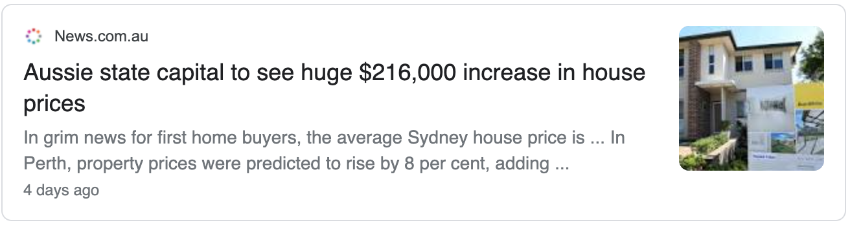
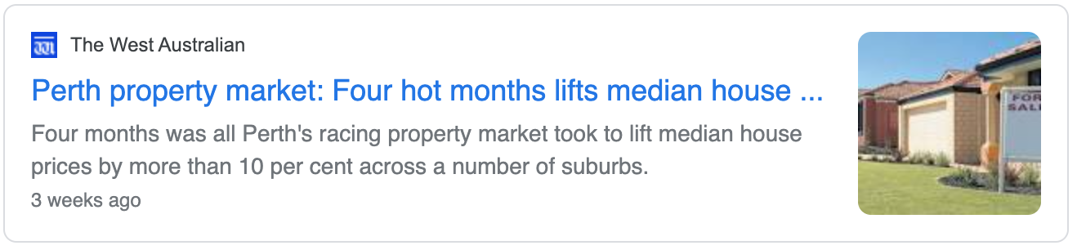

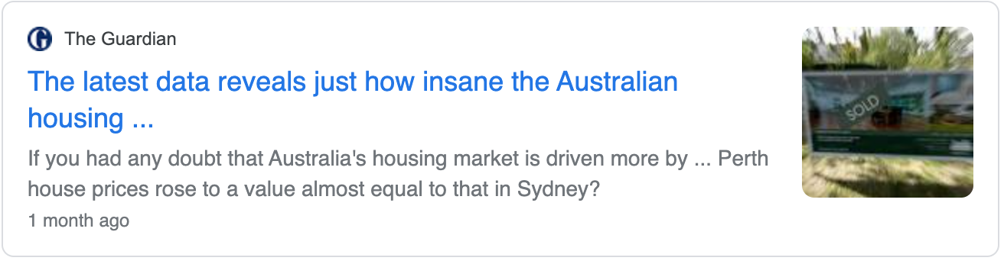
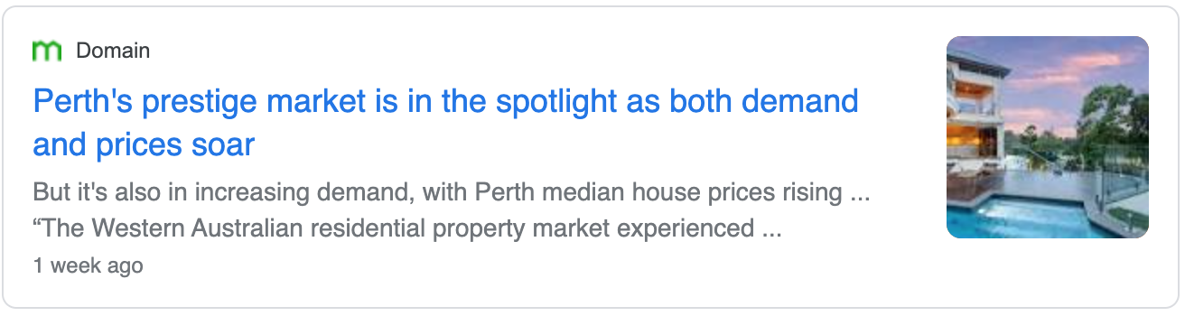
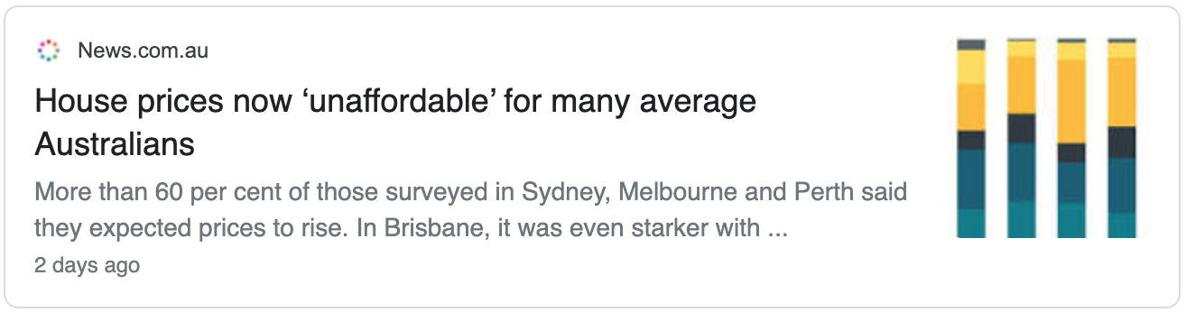
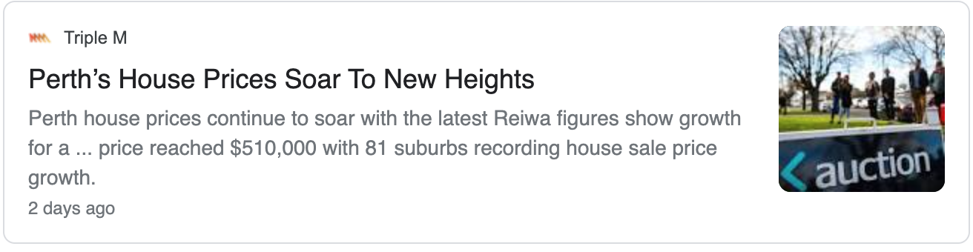
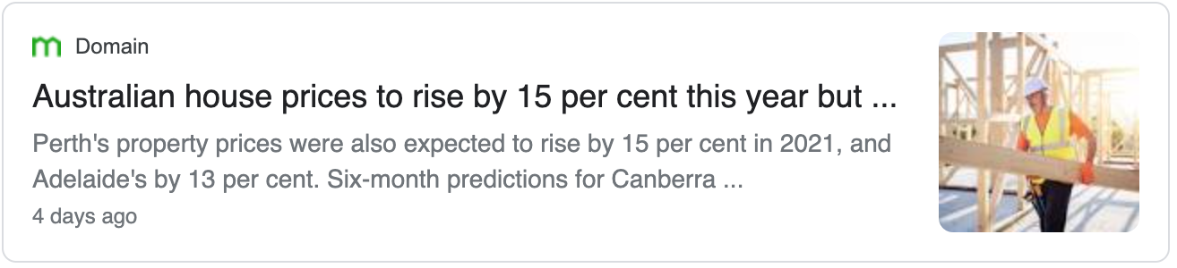
Perth house prices in the news

Slide 3
Which Perth suburb to buy a house in based on specific input parameters?

Slide 4

We will talk about:
What we set out to do
Data sources
Tools used
Methods
Result

Slide 5
What we set out to do
Find relevant house price data for the Greater Perth area
Build a dashboard to help find the location of your new house in the Greater Perth area
Build machine learning engine to train and predict based on user defined input parameters
Build and host web application

Slide 6




Data
Data used:
Perth house prices up to 31 January 2021 (https://www.kaggle.com/syuzai/perth-house-prices)
GeoJson data for WA postcodes / suburbs (https://github.com/tonywr71/GeoJson-Data)
+
+
=

Slide 7






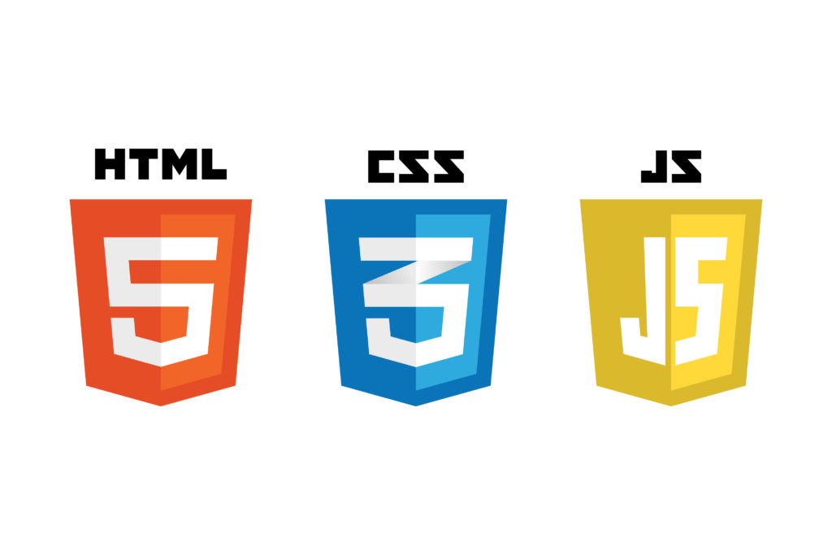



Tools
Python Pandas
Python Seaborn
Python Scikit Learn
HTML / CSS / Bootstrap
JavaScript / Leaflet
SQL Database
Flask / SQLAlchemy
Heroku

Slide 8
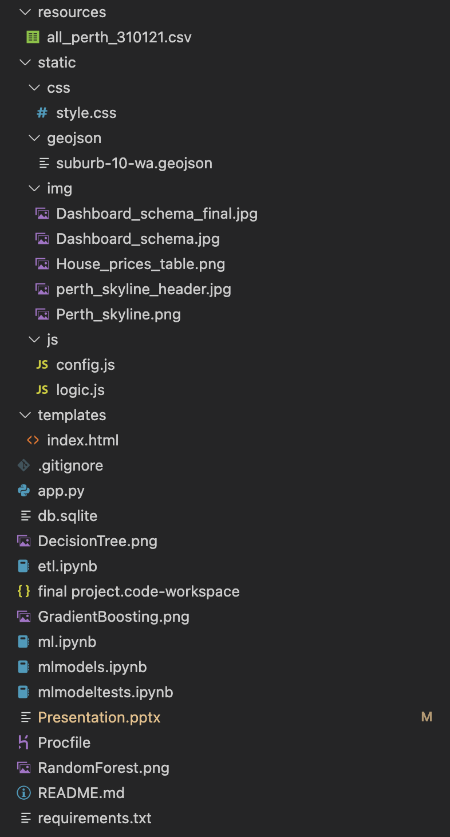
Architecture
resources
static
css
geojson
img
js
templates

Slide 9
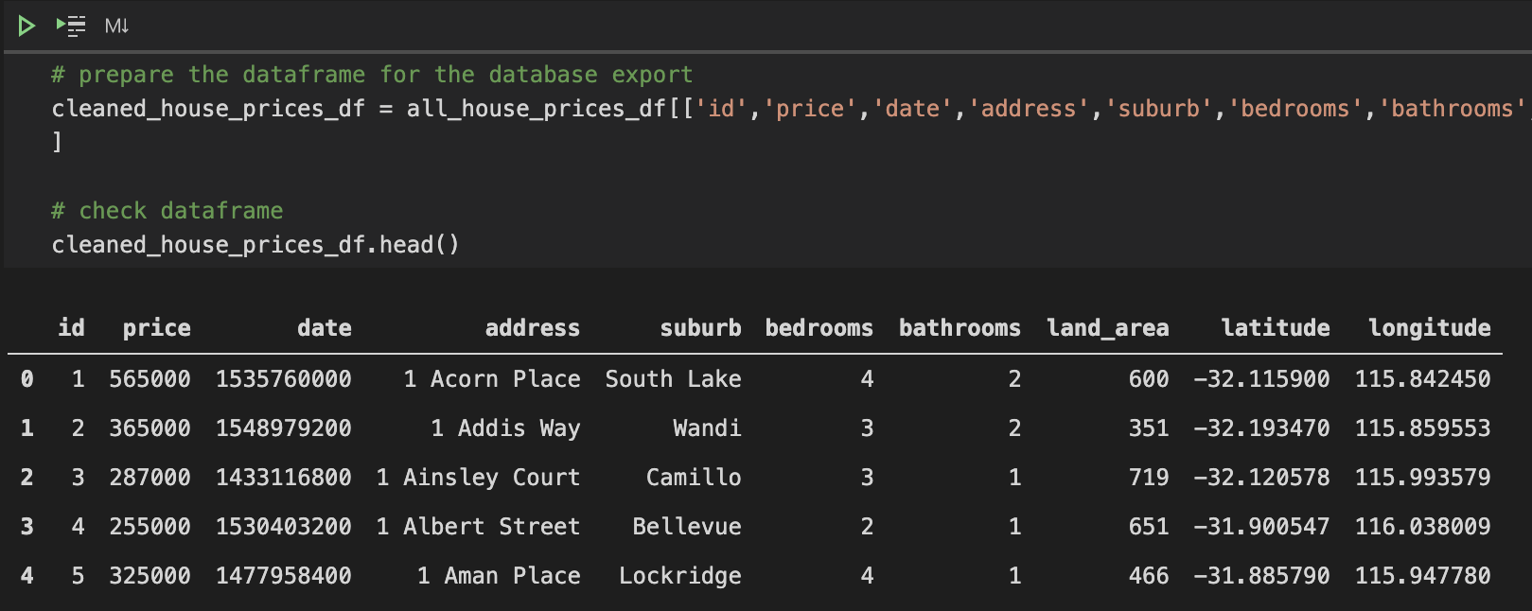
Methods – Data ETL
First step was to clean the dataset
check datatypes
removing NaN
Followed by extracting the relevant columns required for the project
Transforming columns:
add id column for primary key in database
convert date to unix format
rename columns without spaces
Load into SQLite database using SQLAlchemy

Slide 10
Methods – Machine Learning

Slide 11
Methods – Web Application
After completion of the ETL process the data was loaded into a SQLite database
Using Flask-SQLAlchemy the database was made accessible for the web application
render_template
jsonify
request
HTML, CSS and Bootstrap were used for the web page and styles:
index.html
styles.css
HTML input forms used to filter the data from the database

Slide 12
Methods – Web Application
In the HTML reference was made to the relevant libraries and files:
Leaflet.js
D3.js
logic.js
config.js
Prepare map and read in the GeoJson and Jsonified results into the logic.js
Apply machine learning model on the results for the selected month in the future
Use the Chloroplet library to show the number of hits per suburb on a colour scale

Slide 13
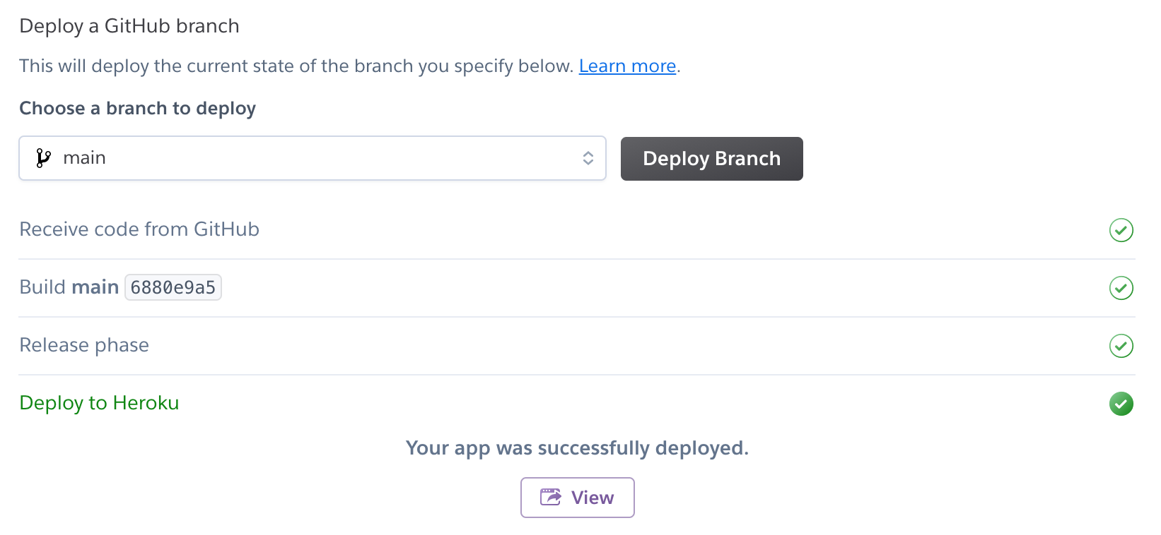

Methods – Web Deployment
Deployment using Heroku:
requirements.txt
Procfile

Slide 14
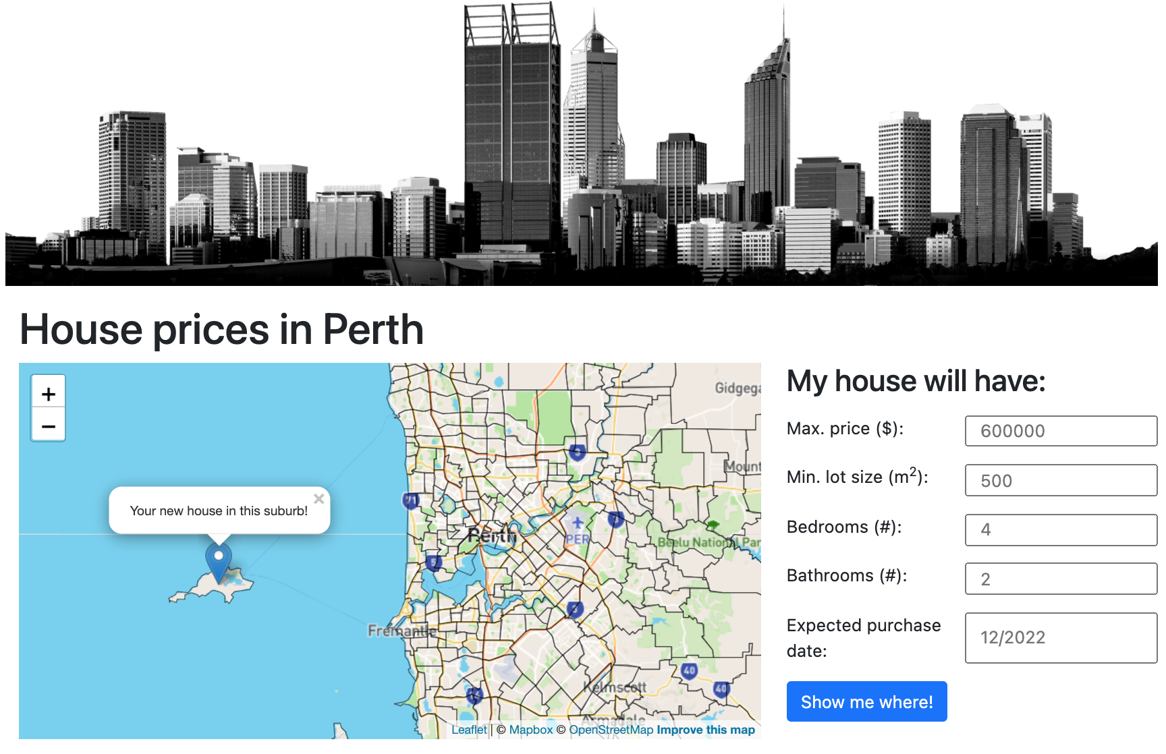
Result

Slide 15
At least we didn’t use pie charts.
- Spiros basilakes & Thierry zonneveld

